Slide 1

Fake News Detection
Open Campus Deep learning Course
Members:
Md Majharul Islam Nayem
FarJana Islam
Junaid Abbas Mohammed
Supervisor: Luca Palmieri

Slide 2

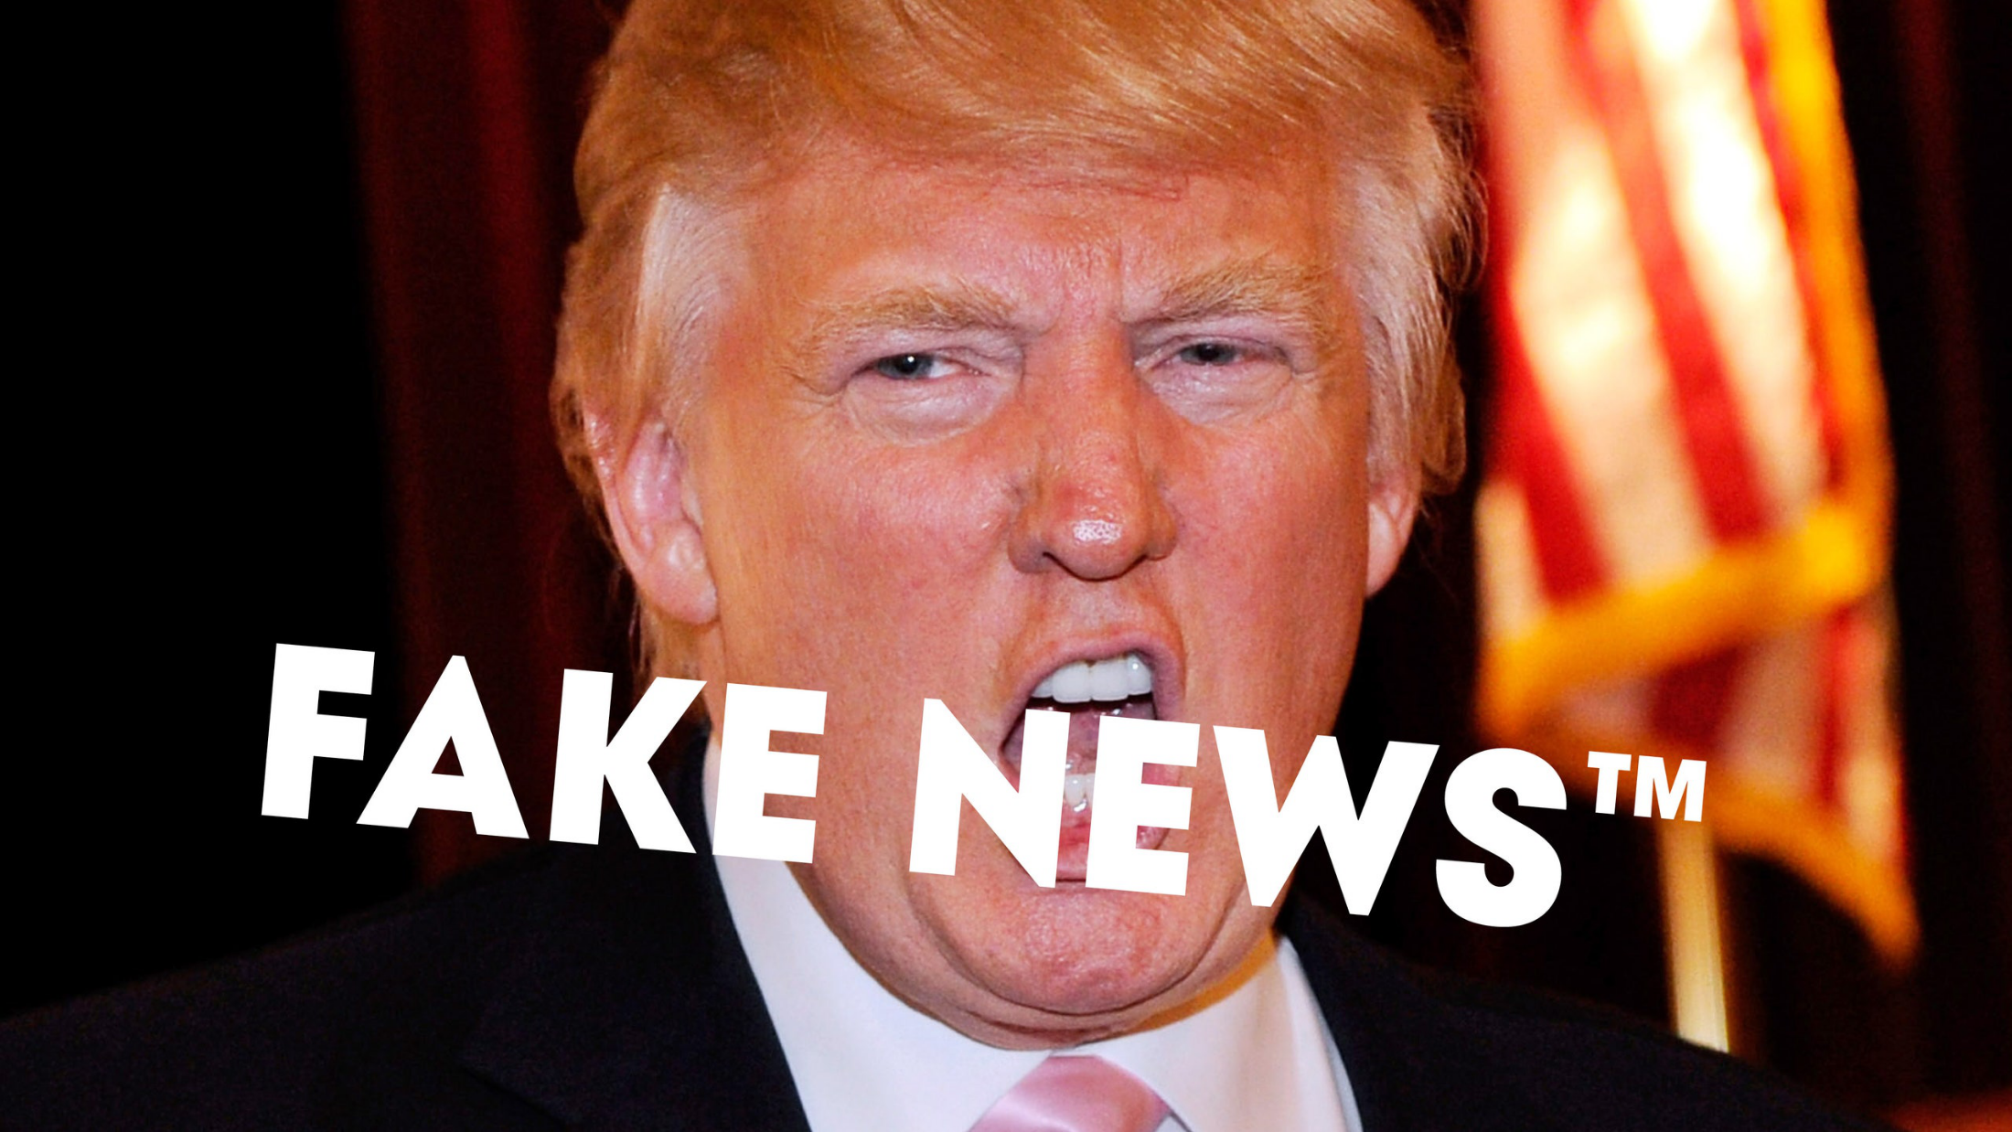
Why Fake News?

Slide 3
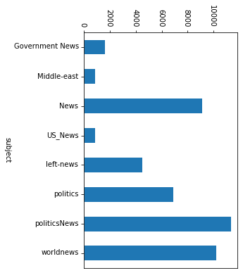
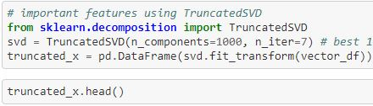
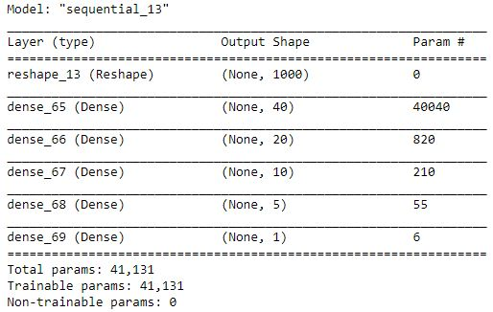
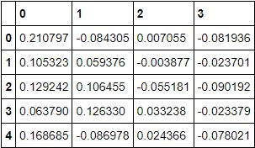
Topics
Dataset
Data Preprocessing
Model (Training and Eval)
Speaker: Farjana
Will be speaking about the Fake & Real News Dataset
Speaker: Nayem
Will discuss about the preprocessing done on the dataset
Speaker: Junaid
Will speak about Model design, training and evaluation of model

Slide 4
Live Demo

Slide 5
Thank you

